Slide 1

Policy Evaluation
Notes:
1

Slide 2
Objectives
Understand the distinction between policy evaluation and control
Explain the setting in which dynamic programming can be applied, as well as its limitations
Apply iterative policy evaluation to compute value functions
2
Policy Evaluation
Notes:
2

Slide 3
Policy Evaluation vs. Control
Policy evaluation is the task of determining the value function for a specific policy.
Control is the task of finding a policy to obtain as much reward as possible: finding a policy which maximizes the value function.
3
Policy Evaluation
Notes:
3

Slide 4
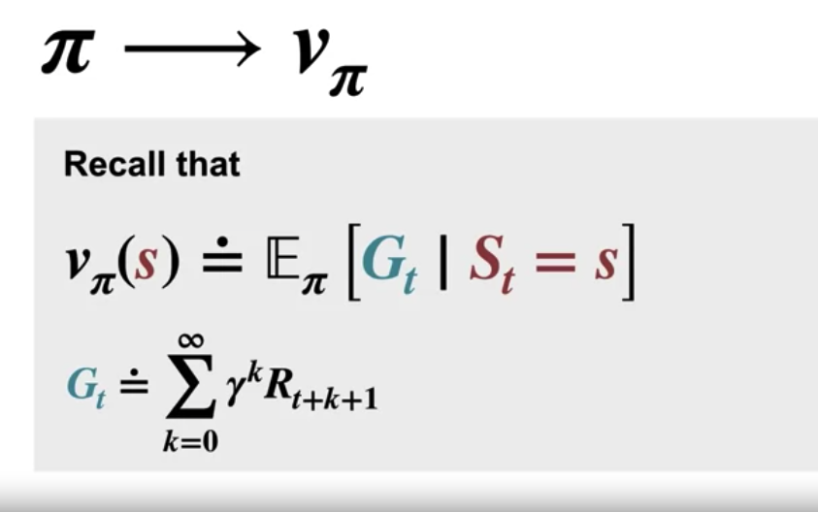
Policy Evaluation vs. Control
Imagine someone hands you a policy and your job is to determine how good that policy is. Policy evaluation is the task of determining the state value function v pi for a particular policy pi.
4
Policy Evaluation
Notes:
4

Slide 5
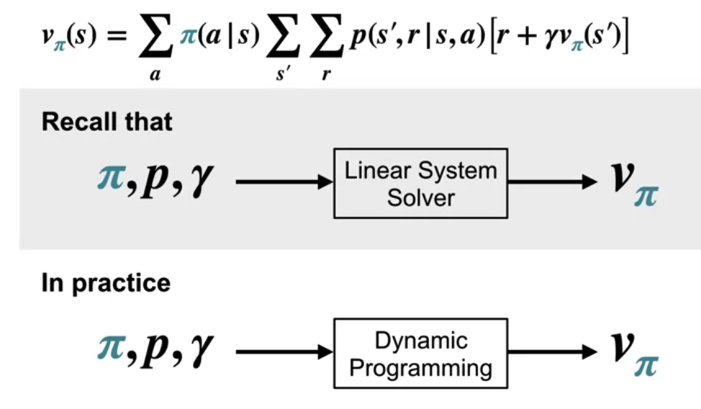
Policy Evaluation vs. Control
The Bellman equation reduces the problem of finding v pi to a system of linear equations
The problem of policy evaluation reduces to solving this system of linear equations.
The iterative solution methods of dynamic programming are more suitable for general MDPs.
5
Policy Evaluation
Notes:
5

Slide 6
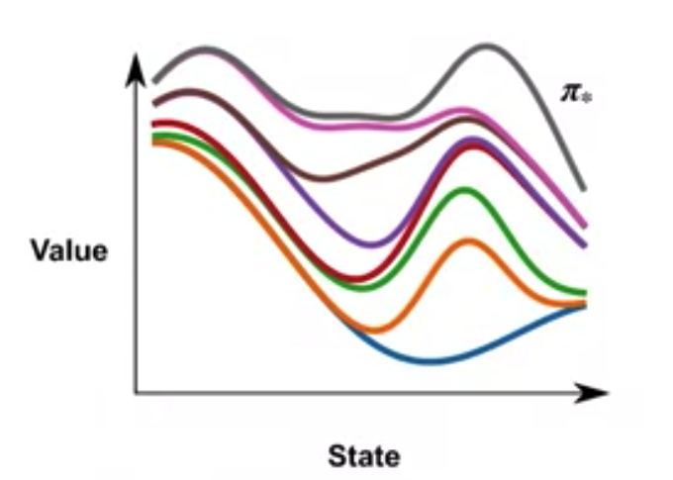
Policy Evaluation vs. Control
Control is the task of improving a policy..
6
Policy Evaluation
Notes:
6

Slide 7
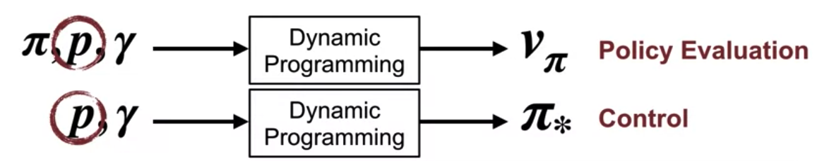
Policy Evaluation vs. Control
The dynamics of the environment: p
We use dynamic programming methods to compute value functions and optimal policies given a model of the MDP..
7
Policy Evaluation
Notes:
7

Slide 8
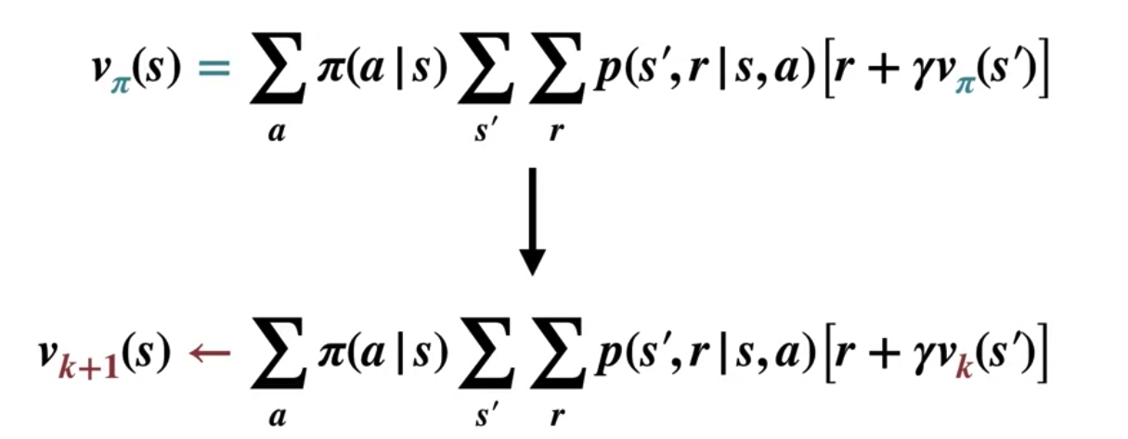
Iterative Policy Evaluation
The Bellman equation gives us a recursive expression for V Pi.
Iteratively refine our estimate of the value function.
8
Policy Evaluation
Notes:
8

Slide 9
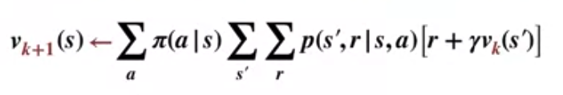
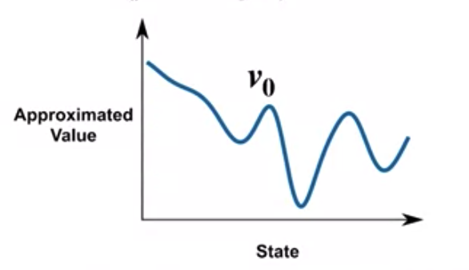
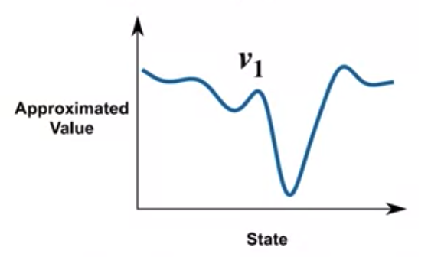
Iterative Policy Evaluation
An arbitrary initialization for our approximate value function- v_0
Using update rule:
9
Policy Evaluation
Notes:
9

Slide 10
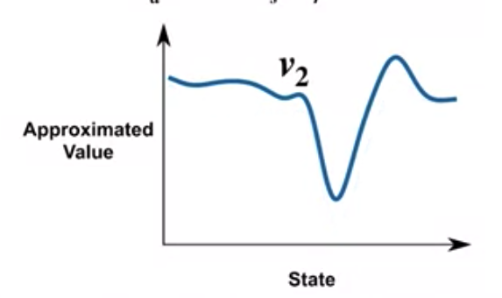
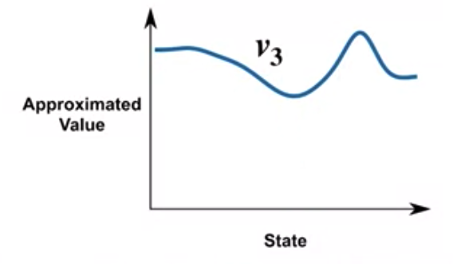
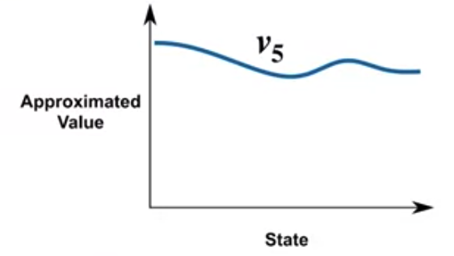
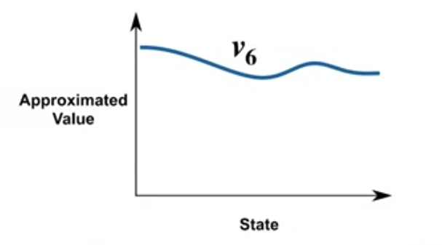
Iterative Policy Evaluation
Update V using interactive
10
Policy Evaluation
Notes:
10

Slide 11
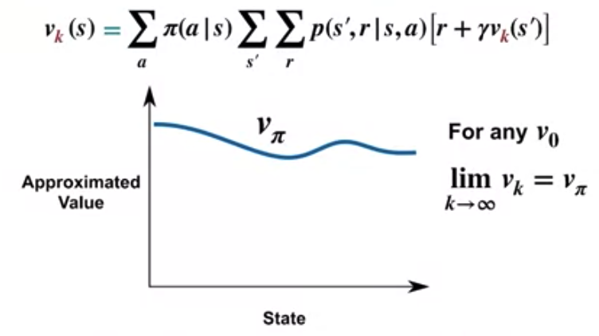
Iterative Policy Evaluation
For any choice of v_0, v_k will converge to v Pi in the limit as k approaches infinity.
11
Policy Evaluation
Notes:
11

Slide 12
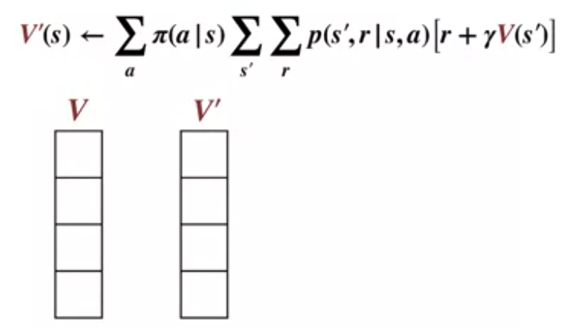
Iterative Policy Evaluation
To implement iterative policy evaluation, we store two arrays.
One array- V stores the current approximate value function.
Another array, V prime, stores the updated values.
12
Policy Evaluation
Notes:
12

Slide 13
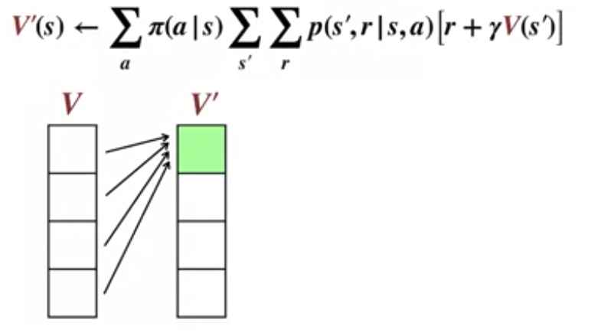
Iterative Policy Evaluation
By using two arrays, we can compute the new values from the old one state at a time without the old values being changed in the process.
13
Policy Evaluation
Notes:
13

Slide 14
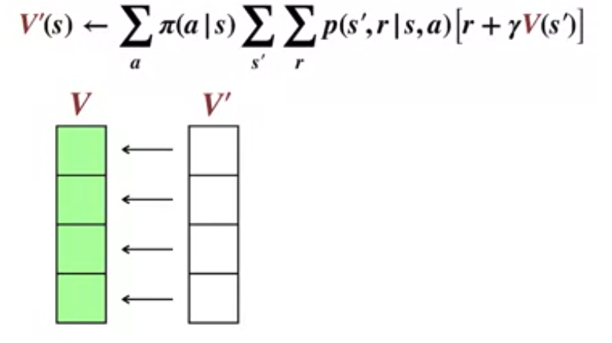
Iterative Policy Evaluation
At the end of a full sweep, we can write all the new values into V; then we do the next iteration..
14
Policy Evaluation
Notes:
14

Slide 15
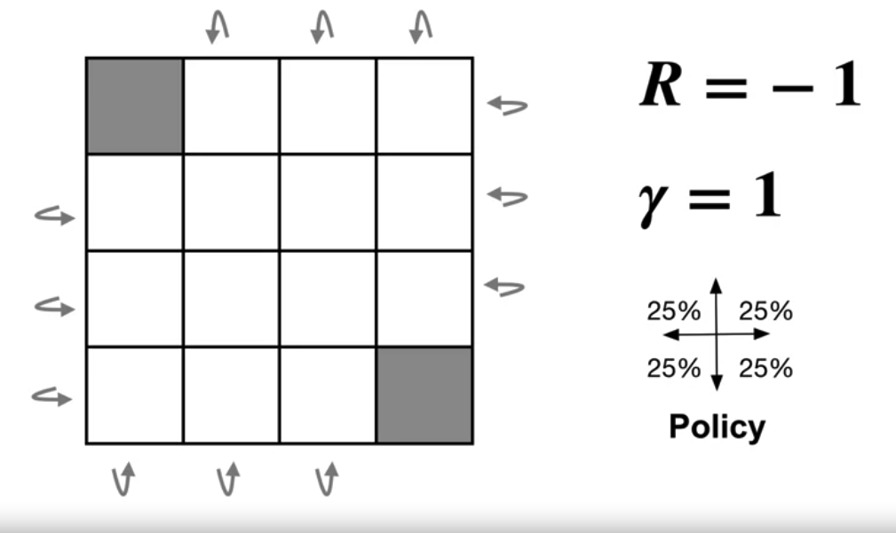
Iterative Policy Evaluation
The four-by-four grid world
The terminal state located in the top left and bottom right corners.
The reward will be minus one for every transition.
gamma equals 1
Four possible actions in each state up, down, left, and right.
15
Policy Evaluation
Notes:
15

Slide 16
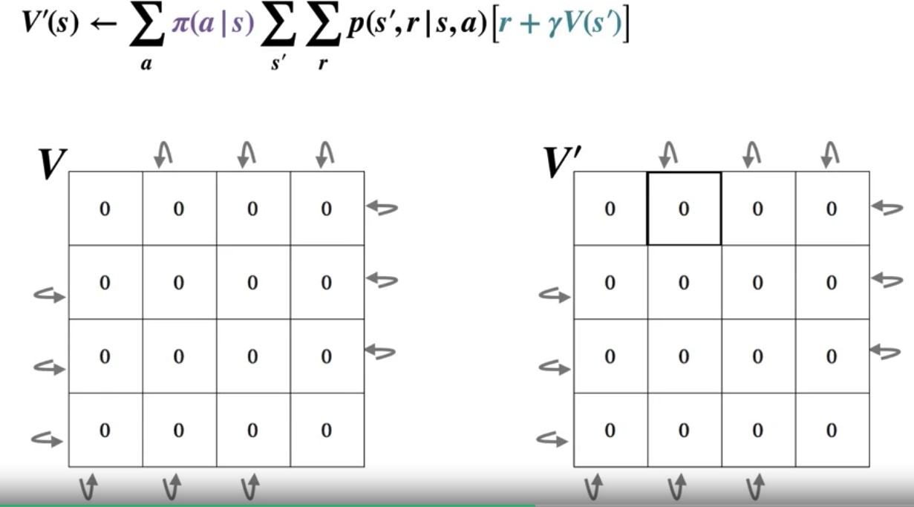
Iterative Policy Evaluation
Calculate:
16
Policy Evaluation
Notes:
16

Slide 17
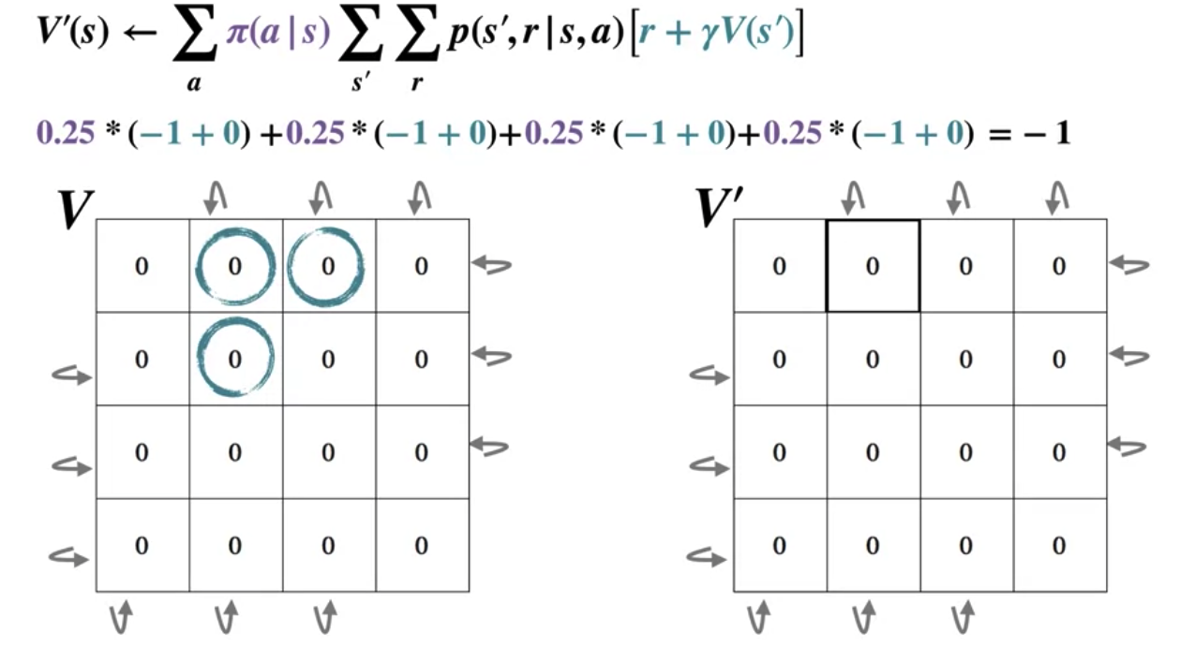
Iterative Policy Evaluation
Calculate:
17
Policy Evaluation
Notes:
17

Slide 18
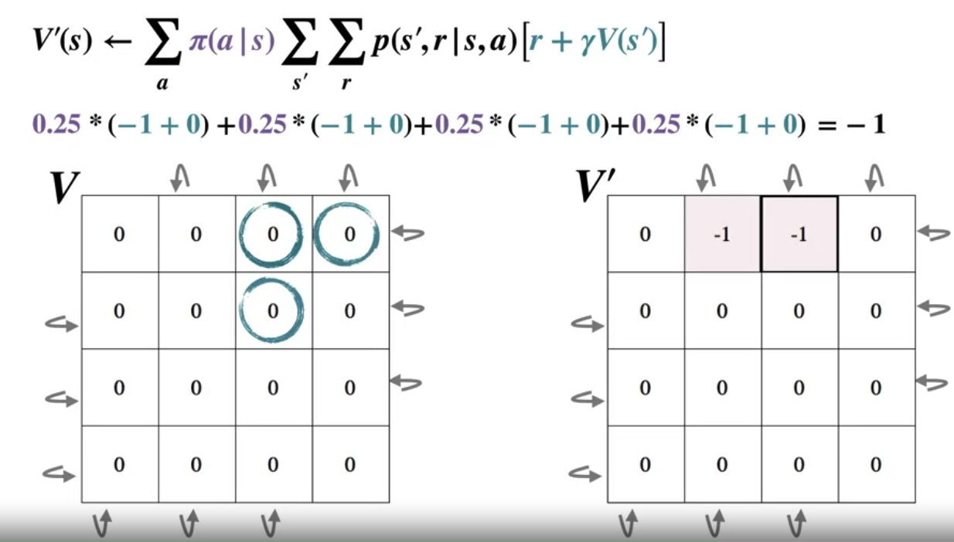
Iterative Policy Evaluation
Calculate:
18
Policy Evaluation
Notes:
18

Slide 19
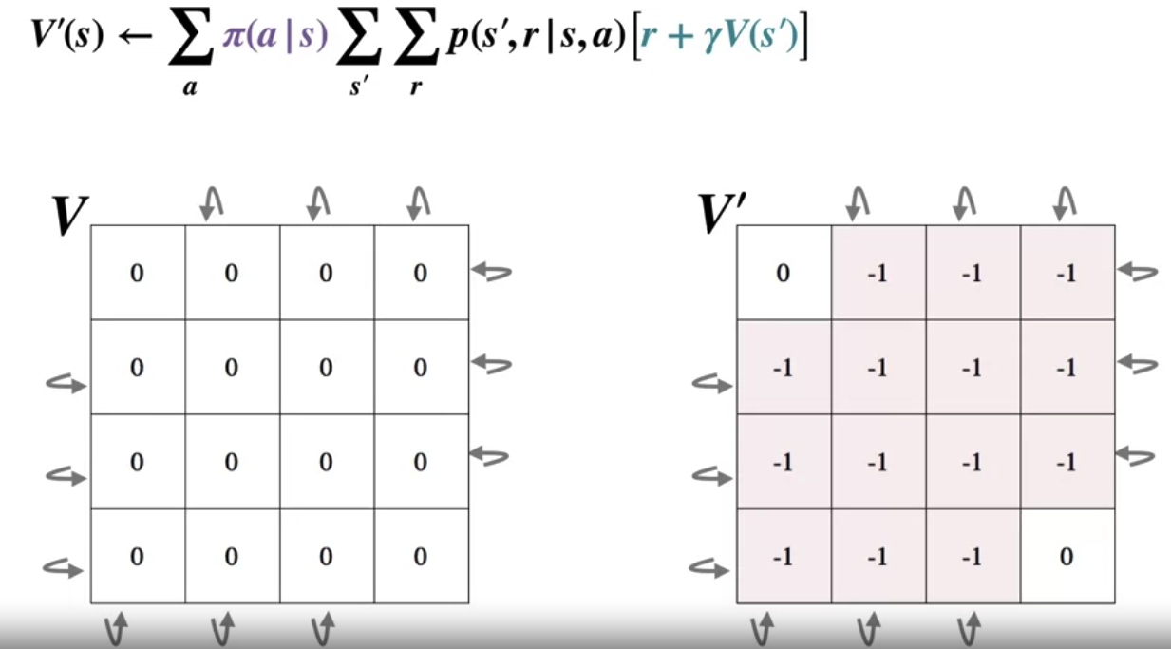
Iterative Policy Evaluation
Calculate:
19
Policy Evaluation
Notes:
19

Slide 20
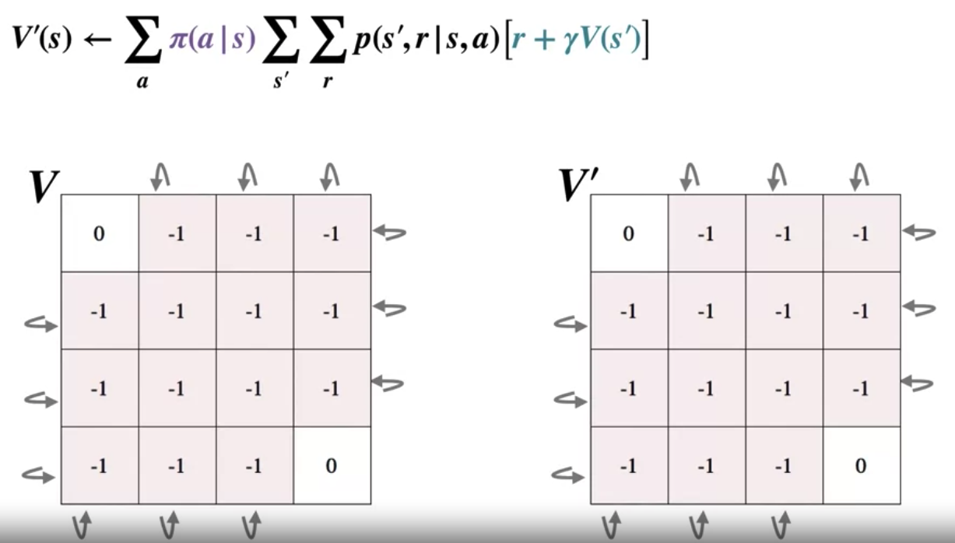
Iterative Policy Evaluation
After completing this full sweep, we copy the updated values from V prime to V:
20
Policy Evaluation
Notes:
20

Slide 21
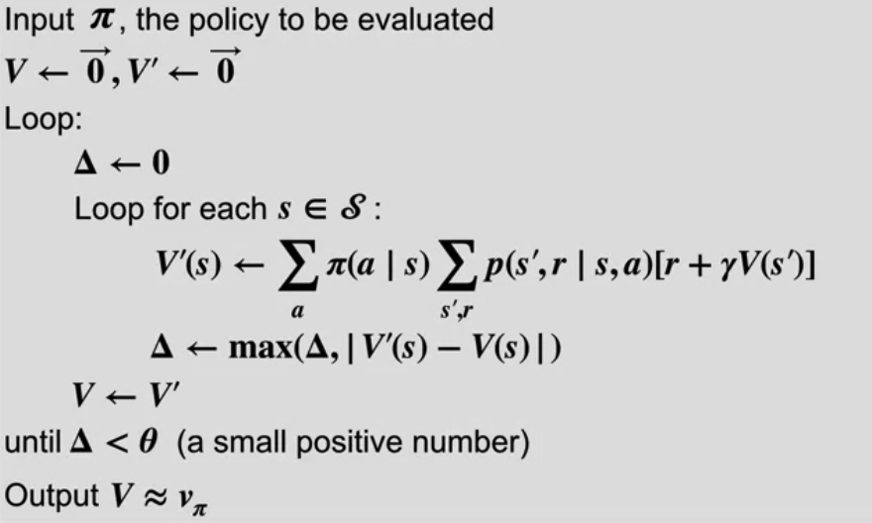
Iterative Policy Evaluation
Iterative Policy Evaluation, for estimating V ~ Vpi:
21
Policy Evaluation
Notes:
21

Slide 22
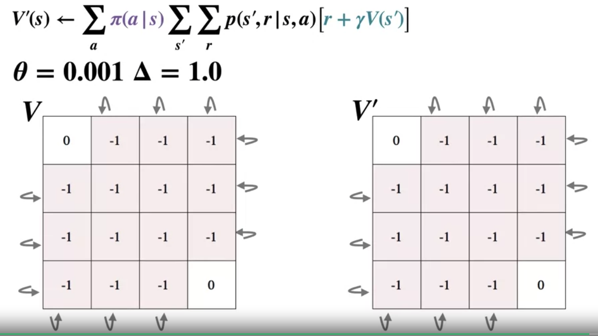
Iterative Policy Evaluation
Our value of 0.001 for the stopping parameter theta
The maximum change in value was 1.0
22
Policy Evaluation
Notes:
22

Slide 23
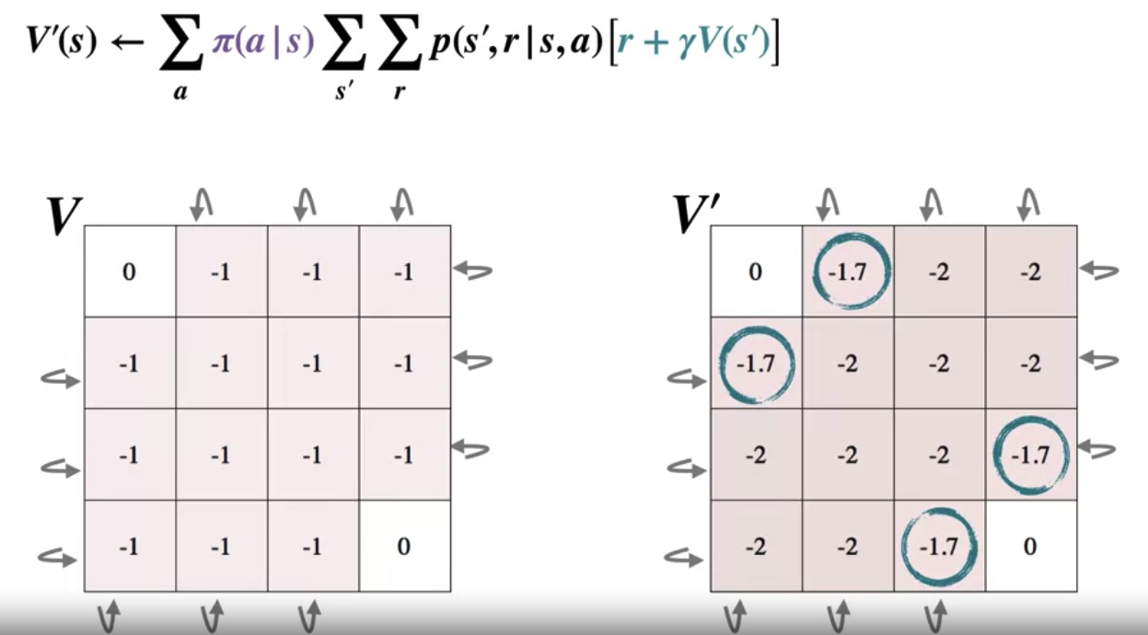
Iterative Policy Evaluation
The second sweep
23
Policy Evaluation
Notes:
23

Slide 24
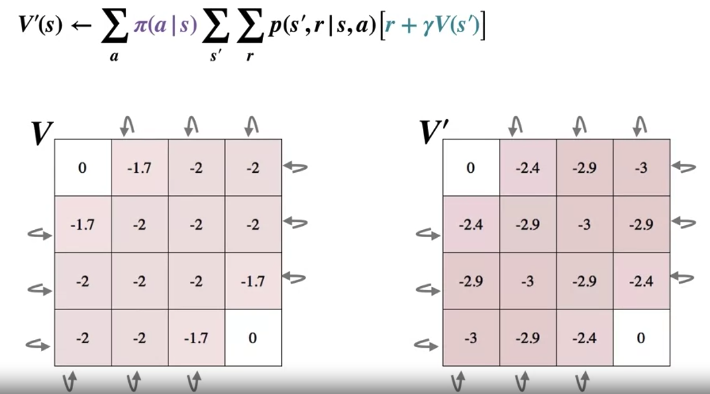
Iterative Policy Evaluation
One more sweep
24
Policy Evaluation
Notes:
24

Slide 25
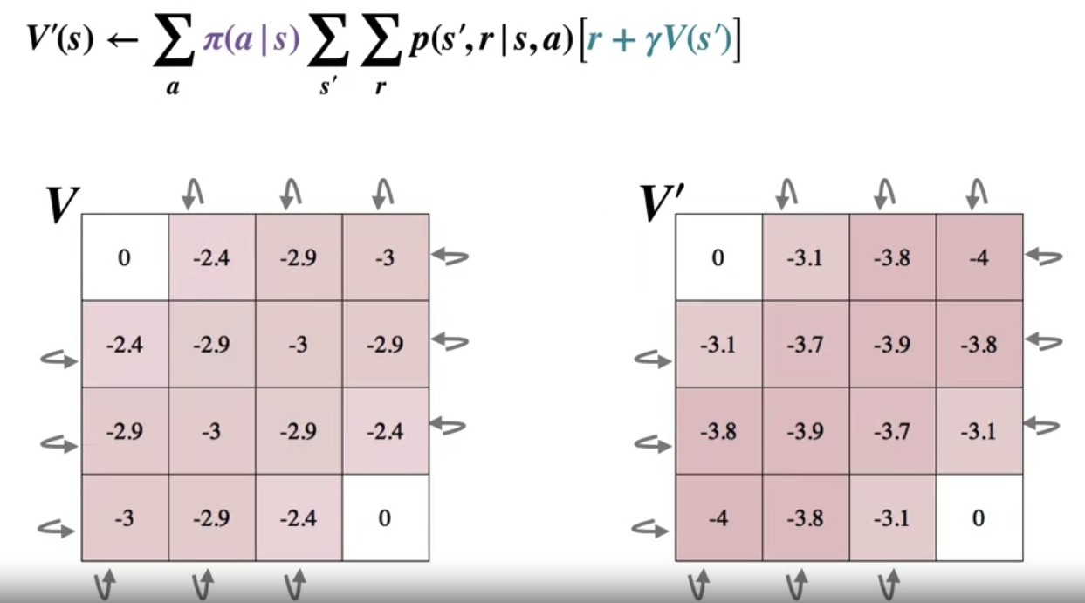
Iterative Policy Evaluation
More sweep
25
Policy Evaluation
Notes:
25

Slide 26
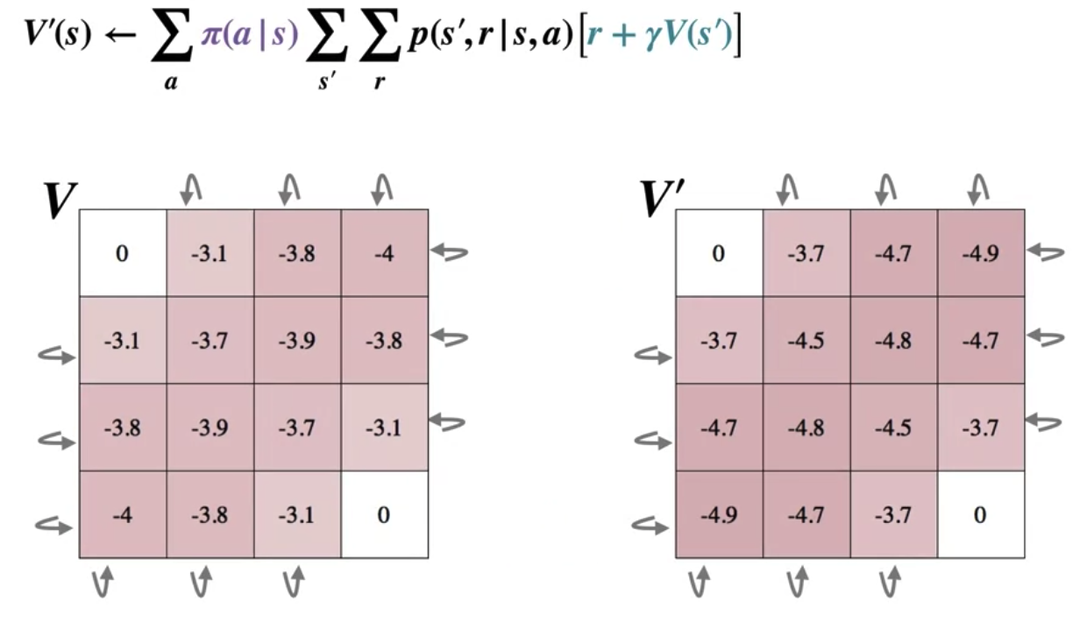
Iterative Policy Evaluation
More sweep
26
Policy Evaluation
Notes:
26

Slide 27
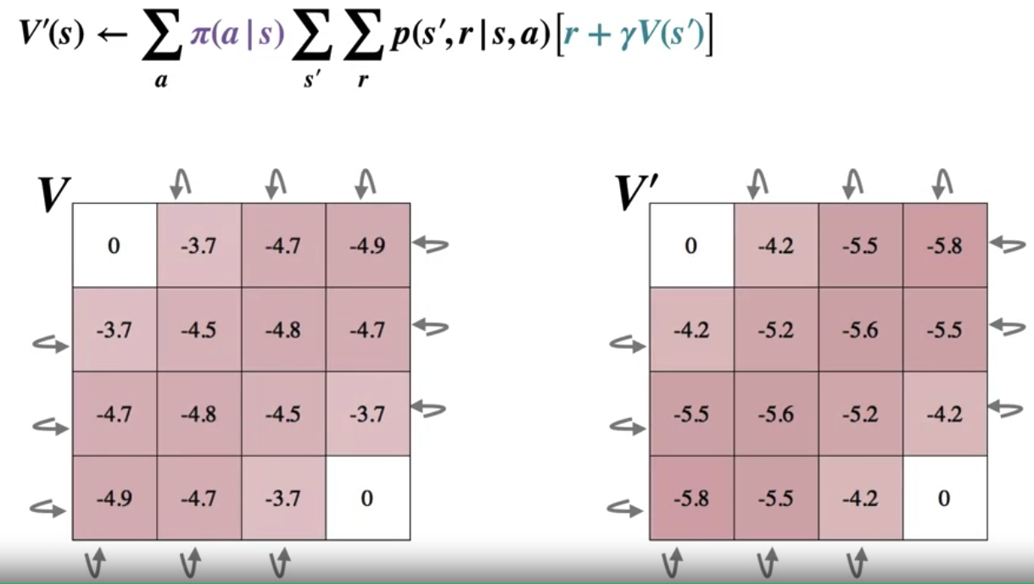
Iterative Policy Evaluation
More sweep
27
Policy Evaluation
Notes:
27

Slide 28
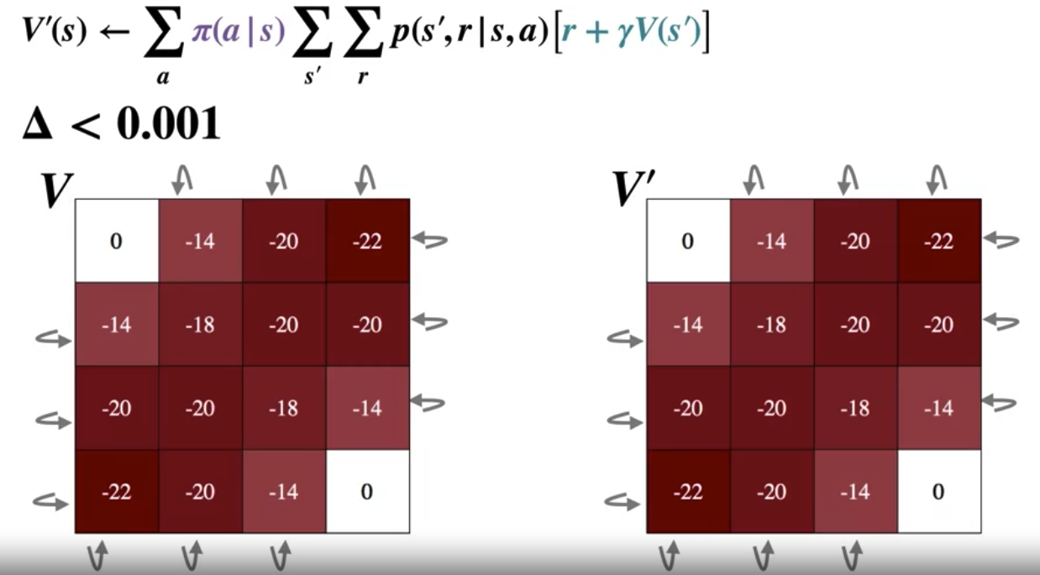
Iterative Policy Evaluation
Keep running until our maximum delta is less than theta.
Our approximate value function has converged to the value function for the random policy
28
Policy Evaluation
Notes:
28

Slide 29
Summary
Understand the distinction between policy evaluation and control
Explain the setting in which dynamic programming can be applied, as well as its limitations
Apply iterative policy evaluation to compute value functions
29
Policy Evaluation

Slide 30
Q & A
30
Policy Evaluation

